Slide 1

Hotel Booking status by using machine Learning Algorithms

Slide 2
CONTEX
Problem statement and discussion of the given data set
Visualization
Steps I had done
Models I had done
Best choice of the Models
Conclusion

Slide 3
1)Problem statement and discussion of the given data set:
This issue statement explains the hostel status, which primarily shows how many people are cancelling their reservations at various locations, as well as some additional criteria that were provided in our data set
. In this data, we must analyse the supplied data and develop a classification model.
The Link of the data set is :https://raw.githubusercontent.com/Premalatha-success/Datasets/main/hotel_bookings.csv

Slide 4
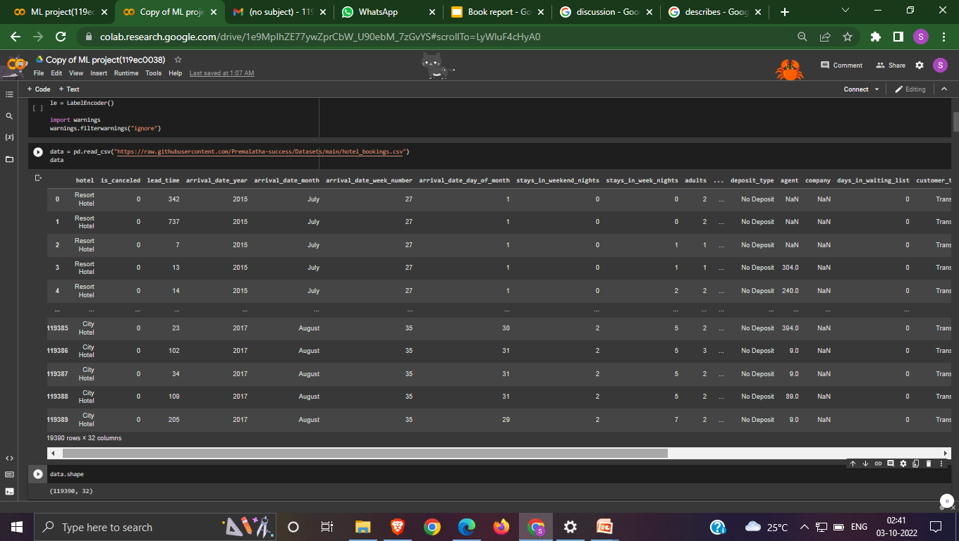
Data Discussion:-
Here are going to see the data in our given data set

Slide 5
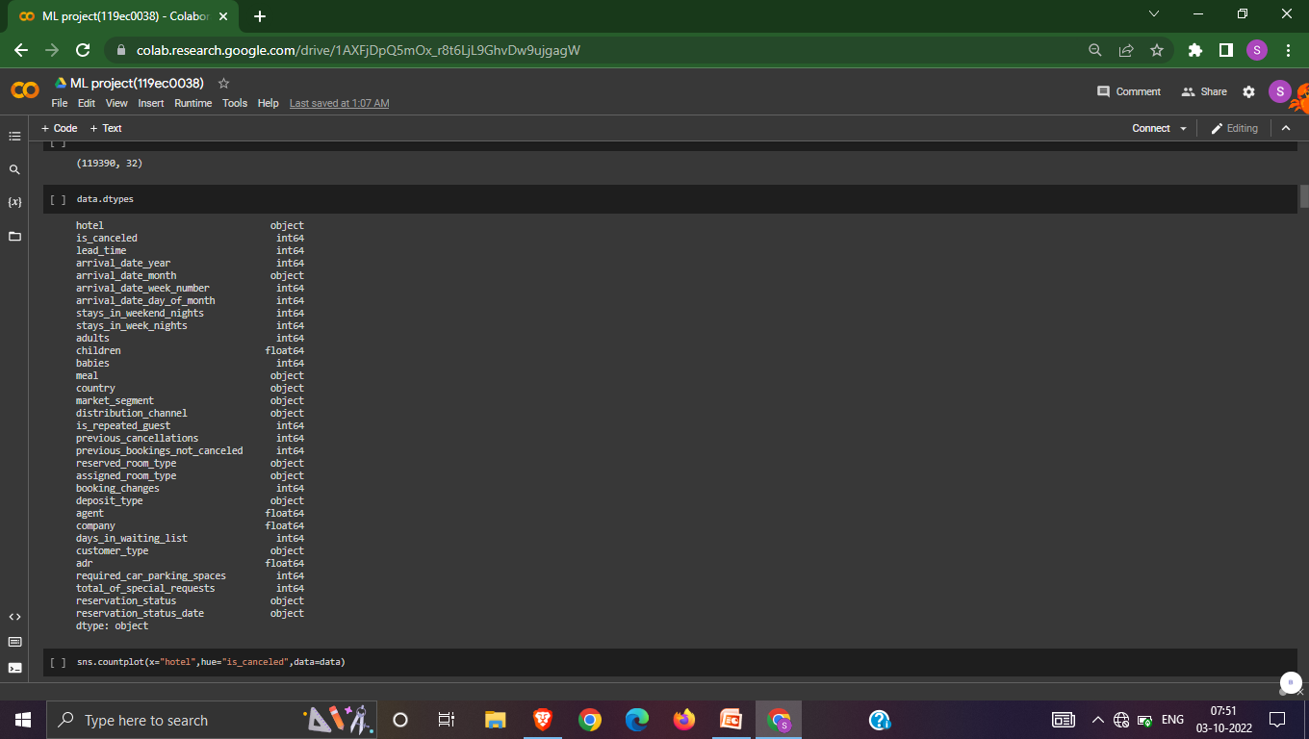
Data Discussion
In side figure it is going tells about data type in given data set

Slide 6
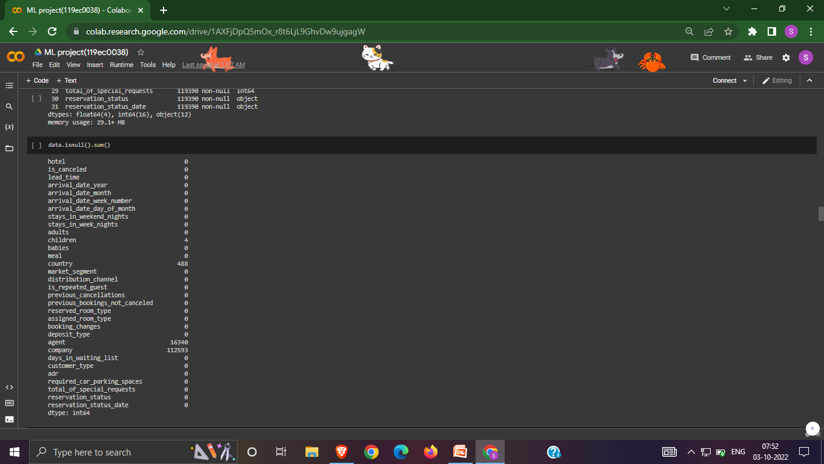
Data Discussion
In side figure it is going tells about data type in given data set

Slide 7
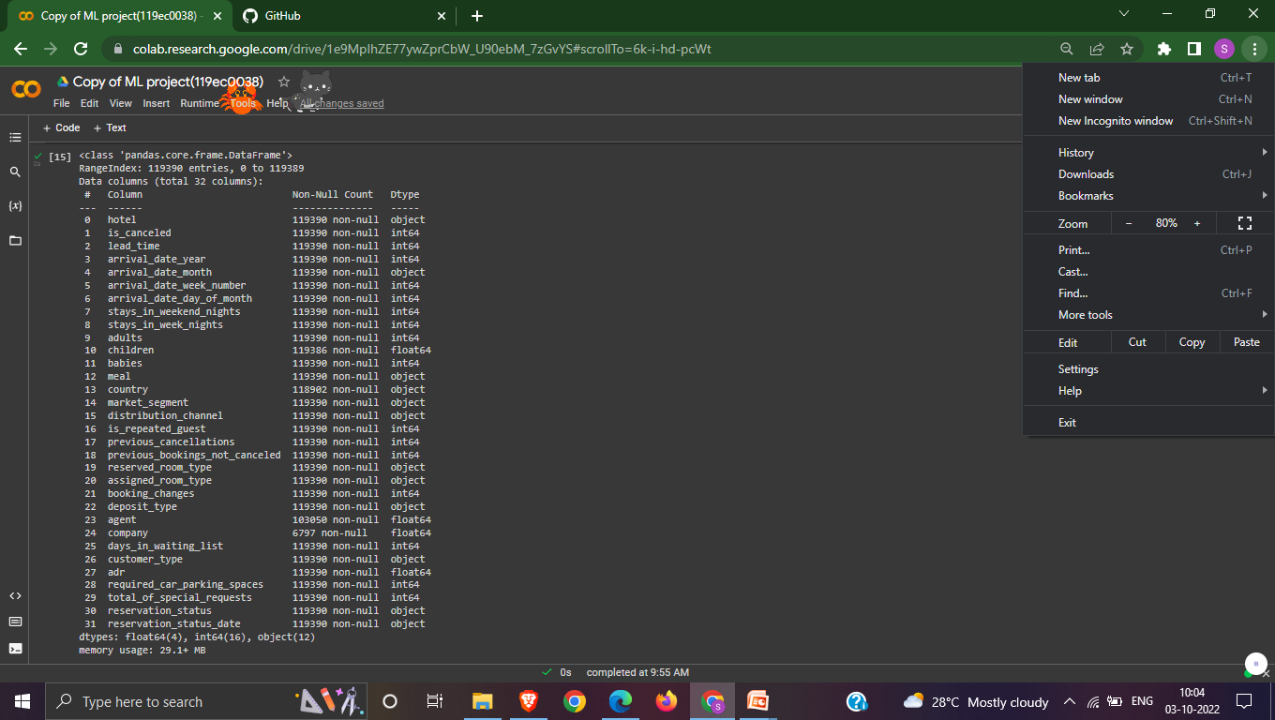
Data Discussion
In Below figure it tell us about the data info

Slide 8
2)Visualization: In this Visualization the plots I had done are snsplot ,heat maps and pair plot.

Slide 9
2)Visualization
Heat map:
1)A depiction of rectangular data presented as a matrix with colours is called a heatmap. It accepts a 2D dataset as a parameter.
2)This kind of data visualisation is excellent since it can display the relationship between variables, including time.
pair plot:
1) In a dataset, pairwise relationships are plotted using a pairplot.
2) We may plot several types of variables on rows and columns or use the pairplot() method to display the subset of variables

Slide 10
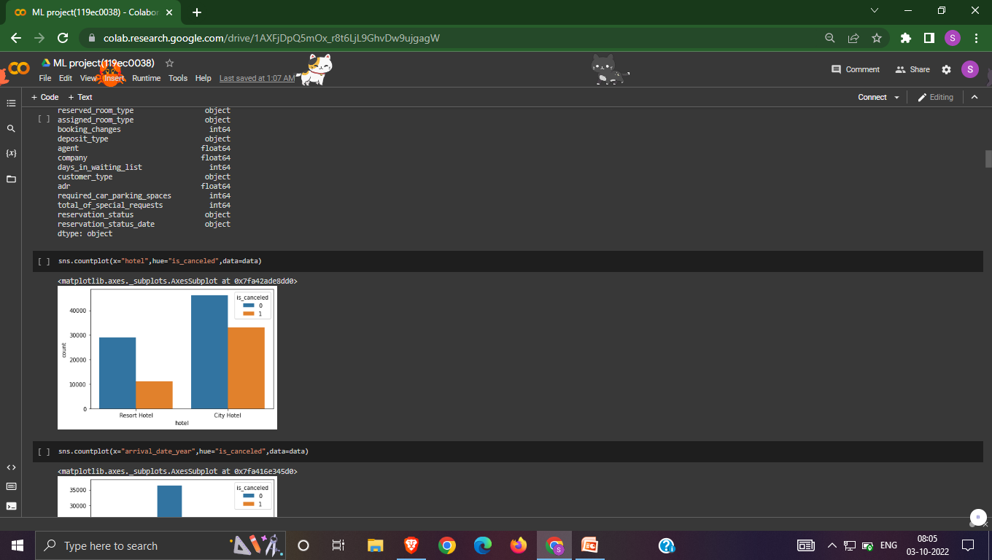
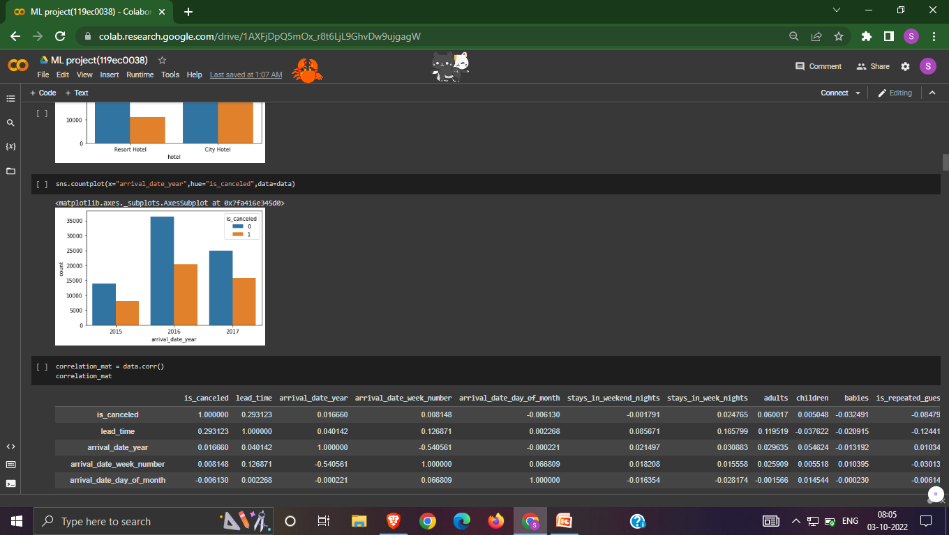
2)Visualization of sns plot
Here we are plotting between meal and is_canceled
Here we are plotting arrival_date_year and is_canceled

Slide 11
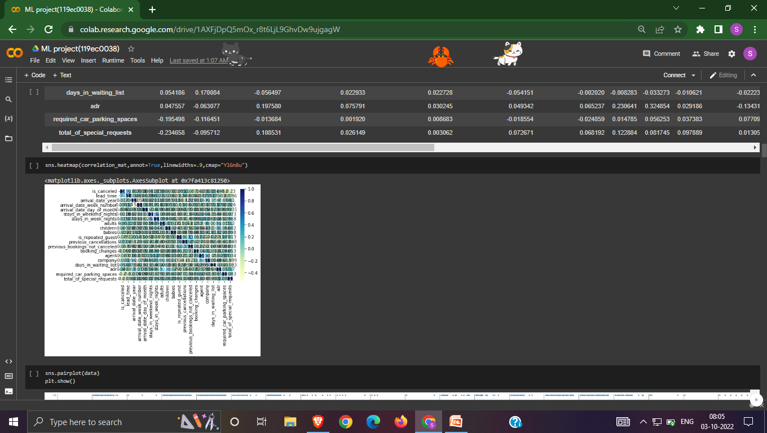
The heat map For correlation of the given data set

Slide 12
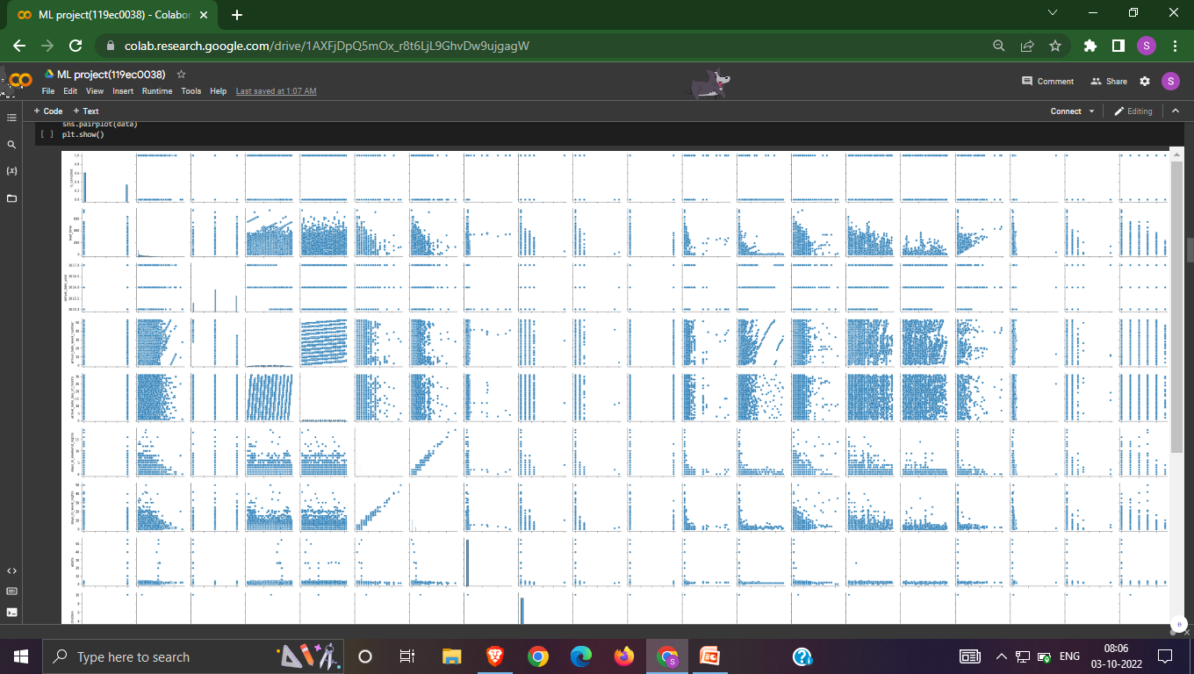
Pair Plot

Slide 13
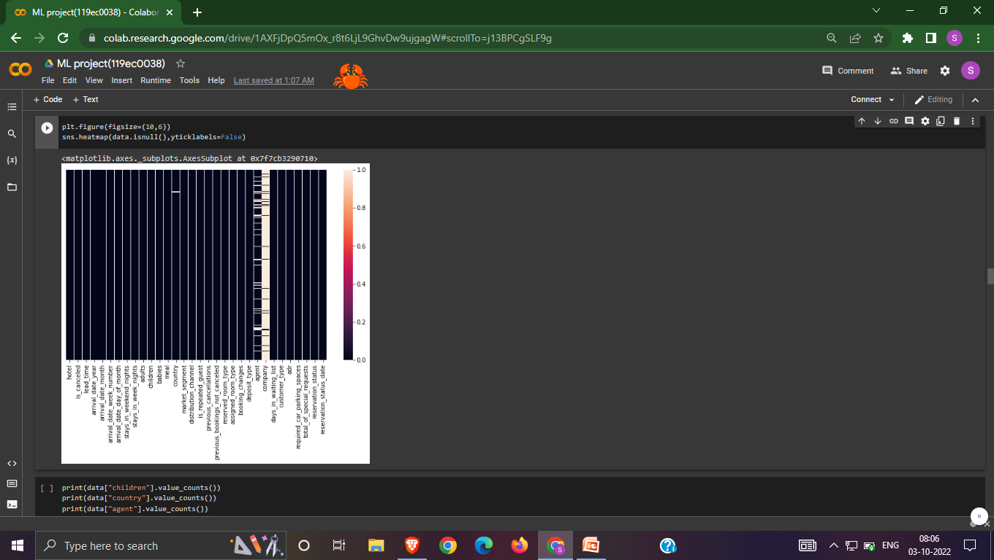
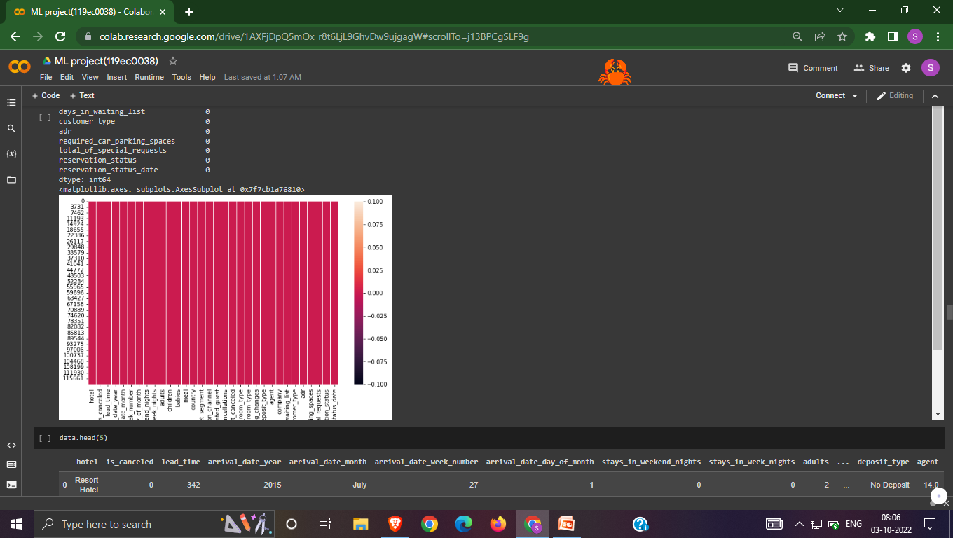
I am plotting null values before and after encoding by heat map:

Slide 14
3)Steps I had Done
Here I had 4 steps to do this project
1)Step 1 Import the packages numpy,pandas,matplotlib,seaborn,sklearn,train test split,metrics
2)Step 2:Load the Dataset
3)Step 3:Explore the data-shape,visualisation
4) Step 4:X,y-->train data test data->Fit the model with training data predict with the test data

Slide 15
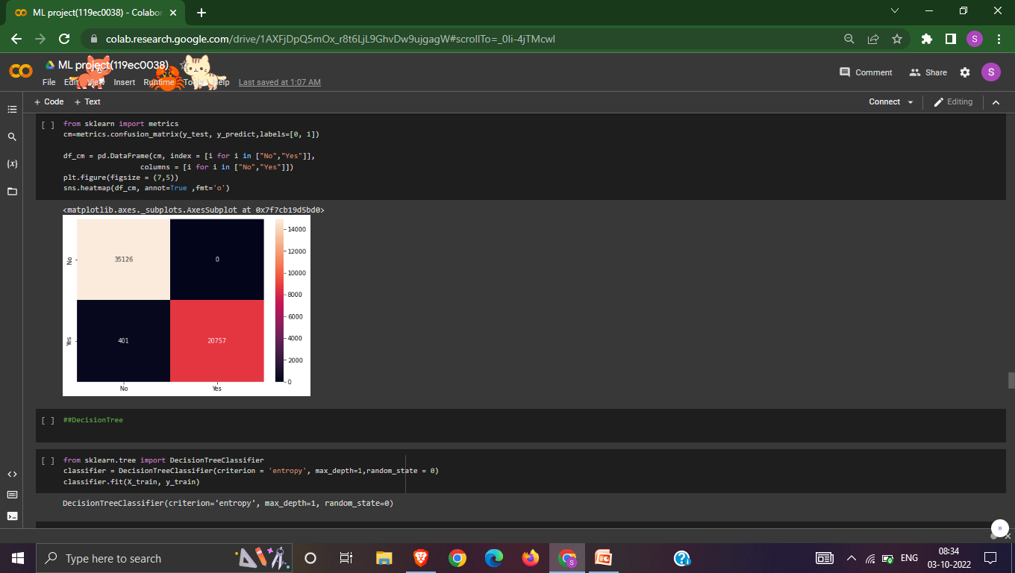

4)Models I had done
DecisionTree
logistic regression

Slide 16
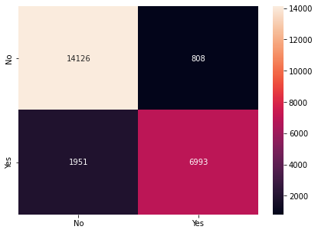
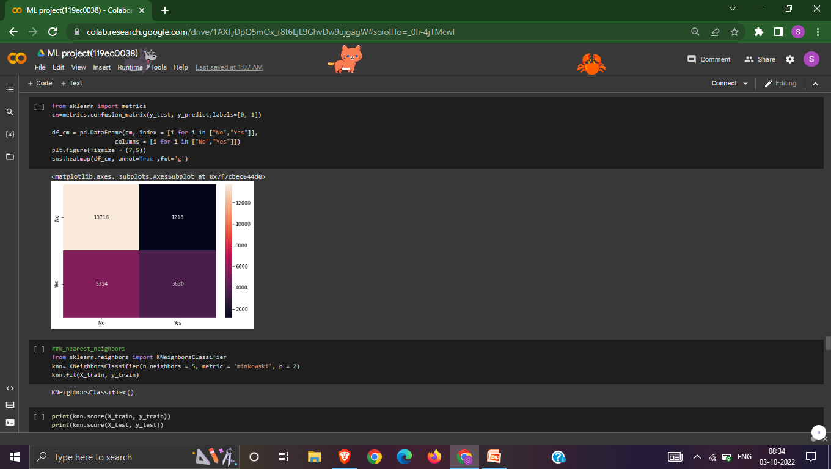
4)Models I had done
Support Vector Machine
k_nearest_neighbors

Slide 17
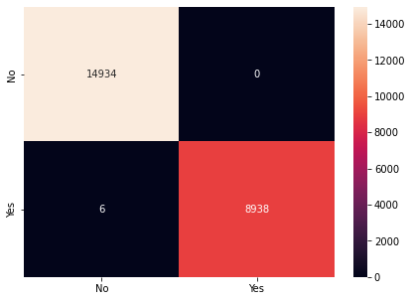
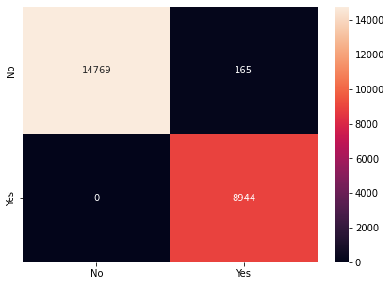
4)Models I had done
naive_bayes
RandomForest

Slide 18

4)Models I had done
Bagging
AdaBoost

Slide 19
4)Models I had done: GradientBoostingClassifier

Slide 20
5)Best choice of the Models :# GradientBoostingClassifier
I tested each of the nine classified ML Algorithms, but I decided on the Gradient Boosting classifier since it has a 100% accuracy rate, zero confusion matrices (Q1 and Q3), and it runs very fast .
It is predicated on the hunch that when prior models are coupled with the best feasible upcoming model, the overall prediction error is minimised.

Slide 21
6) Conclusion
In this project, I employed eight machine learning classification algorithms to determine the cancellation status of hotel rooms based on the provided data set.
Following the visualisation of features in the data set using training and testing data.
For logistic regression
Training:0.990053605829634
Testing: 0.9892369545188039

Slide 22
6) Conclusion
DecisionTree
Training:0.990053605829634
Testing:0.9892369545188039
Support Vector Machine
Training:0.7269453053019516
Testing: 0.7264427506491331
k_nearest_neighbors
Training: 0.9221668481447357
Testing: 0.8844543094061479

Slide 23
6) Conclusion
Naive_bayes
Training: 0.9929223553061396
Testing: 0.9930898735237457
Random Forest
Training: 0.9999895301113996
Testing: 0.9997487226735907
Bagging
Training:1.0
Testing:1.0

Slide 24
6) Conclusion
Ada Boosting
Training:1.0
Testing:1.0
Gradient Boosting
Training:1.0
Testing:1.0
By seeing the training and testing for each classifier, I can conclude that the classifiers with lower accuracy will take longer to compile.

Slide 25
Thankyou
BY
Sathwik Kanaparthi
119ec0038

